Slide 1
GRAMMENER CASE STUDY
Submitted By : Srinivasan. G, Naveed.J, Denny.J and Kumar.A Date of Submission : 30-December-2018 Batch : September - 2018

Slide 2
Problem Statement
A Consumer Finance Company lends various types of loans to urban customers
If the Applicant is likely to repay the loan and if loan is rejected for this applicants then its loss of Business to the company
If the applicant is not likely to repay the loan and if loan is approved for this applicants then this would lead to Financial loss to the company
To avoid this, the company wants to know the potential patterns if a person likely to default i.e. not repay altogether or not in time

Slide 3
Methodology Applied
Data Cleaning
Fix rows, columns, Null and Invalid Values
Standardize, Transform, Deduplicate
Univariate Analysis
Analyze one Variable at a time
Data distribution, Summary Metrics
Bivariate
Analysis
Analysis on Continuous Variables
Correlation between variables
Segmented Univariate analysis – Comparison of averages and metris

Slide 4
Data Analysis & Cleansing
There are 111 columns or variables in the loan data frame.
Remove NULL or Missing or Invalid Values
54 columns from the loan has all values NULL is removed
Remove columns have more than 70 % ONLY has 0 , NA or both
Removed columns which non-essential for analysis
Standardize, Transform and Deduplicate
Transform Month & Year to standard Datetime Format
Remove redundant key attribute – member_id
Transform ‘%’ from columns and convert to numeric
Convert columns which are Non-numeric to Numeric format
Standardize all string columns/attributes to common (Upper) Case.
Filter out rows to new data frames based on Loan Status for analysis

Slide 5
Overall Loan Status
After Data Cleansing the filtered data frames have ;
Charged off – 5627 rows and 41 columns (14%)
Full Payment – 32950 rows and 41 columns (83%)
Current – 1140 rows and 41 columns (3%)
The customer & loan attributes that influence the tendency to default the loan leading to ‘credit loss’ are considered .
The loan status not `Current` ( Charged Off & Fully-Paid loan status) .
For credit loss analysis ,only data associated with charged off loan status.

Slide 6
Univariate Analysis
Overall Loan status and charged off Loans
Variables against the number of charged off loans such as ;
Categorical Variables (Nominal & Ordinal)
Term, Verification Status, Grade, Sub Grade and Employee Experience
Home Ownership and Resident State
Purpose
Continuous Variables (Interval)
Loan Amount,
Funded Amount , Funded Amount Invested,
Interest Rate
Instalment, Annual Income, DTI,
Revolving Balance and Revolving Utility %
Issue Date, Pulled Credit Date, Last Credit Payment Date
Refer Section 3.1 Univariate Analysis in Jupyter Notebook for the details

Slide 7
Bi-Variate Analysis
It includes the below for the charged off loans ;
Home ownership against Verification Status
Segmented Annual Income Group (Bins)
For Term
Verification Status
Segmented Annual Income Group
Interest Rate Group (Bins)
For Term
Employee Experience
Correlation analysis
Loan Amount against Funded Amount for different purpose
Funded Amount Invested against Instalment for different purpose
Loan Payment against Loan Payment Invested for different purpose

Slide 8
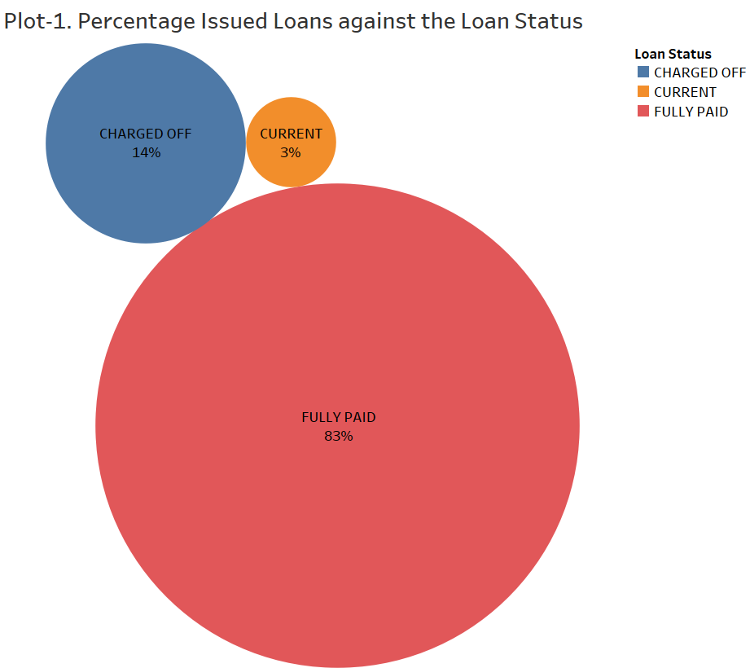
Overall Loan Status
Insight-1 :
[1] ~ 14% out of all issued loans under consideration have resulted in credit loss.

Slide 9
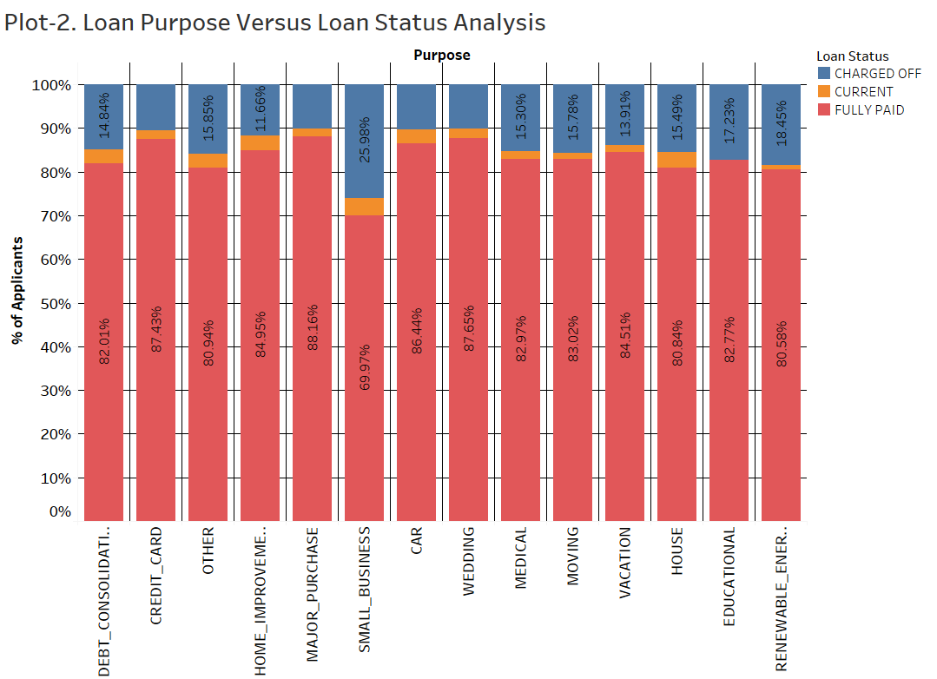
Loan Purpose versus Loan Status Analysis
Insight-2 :
[1] Although the highest number of loan applications are received from debt consolidation From the plot percentage of defaulter's loan purpose is highest for small business,
[2] 26% of all loans taken from small business result in credit loss to the company.
[3]
Loan Purpose | Charged Off | Current | Fully Paid | Grand Total | Fraud %
SMALL_BUSINESS | 475 | 74 | 1279 | 1828 | 26.0
RENEWABLE_ENERGY | 19 | 1 | 83 | 103 | 18.4
EDUCATIONAL | 56 |  | 269 | 325 | 17.2
OTHER | 633 | 128 | 3232 | 3993 | 15.9
MOVING | 92 | 7 | 484 | 583 | 15.8
HOUSE | 59 | 14 | 308 | 381 | 15.5
MEDICAL | 106 | 12 | 575 | 693 | 15.3
DEBT_CONSOLIDATION | 2767 | 586 | 15288 | 18641 | 14.8
VACATION | 53 | 6 | 322 | 381 | 13.9

Slide 10
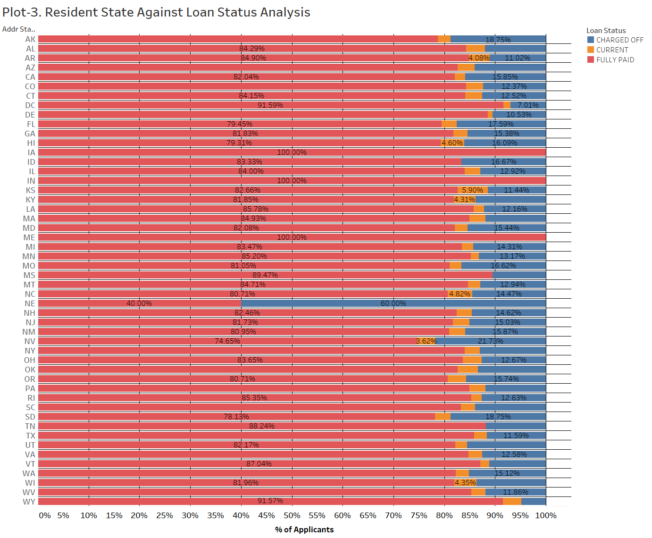
Application Resident State versus Loan Status Analysis
Insight-2 :
[1 From the proportionality plot the borrowers belonging to state of Nebraska and Nevada (with 60% and 22.5% respectively) contribute to the highest default percentage. However the sample size for the state of Nevada is only 5. Therefore disregarding it and the next highest state is Nebraska.
[2] The Highest number of loan applications are received from California, New York, Florida, and Texas. Their respective default rates are 16.2%,13.4%, 18.1% and 11.9%.
[3]
State | Fully Paid | Charged Off | Grand Total | Fraud %
CA | 5824 | 1125 | 6949 | 16.2
NY | 3203 | 495 | 3698 | 13.4
FL | 2277 | 504 | 2781 | 18.1
TX | 2343 | 316 | 2659 | 11.9
NV | 371 | 108 | 479 | 22.5
NE | 2 | 3 | 5 | 60.0

Slide 11
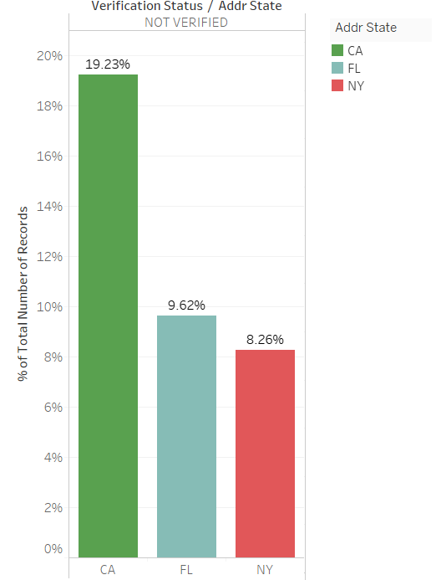
Top 3 States Approved Loan without Verifying
California has the highest number of borrowers
where are provided without verifying the their source of
Income at 19%, followed by Florida and New York at 10%
and 8% respectively.

Slide 12
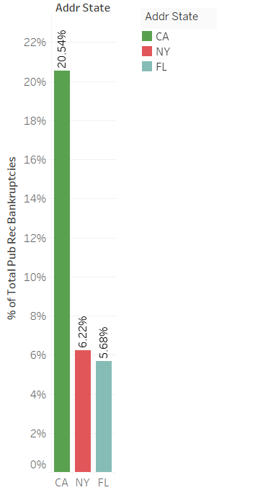
Top 3 States – Pay Installment Late
Based on the graph we can infer that California, New York
followed by Florida still remain the top three states where the
installments are paid late.

Slide 13
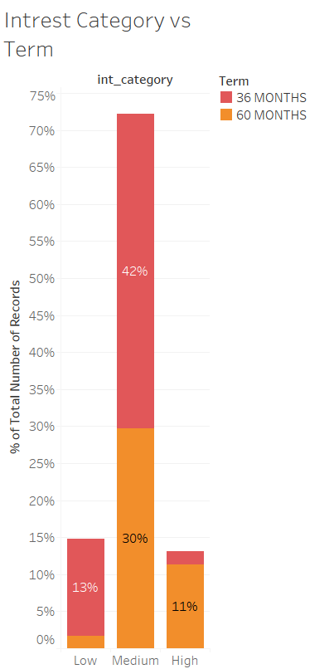
Interest Category Vs Term
Most of the borrowers falls in the medium category
and prefer a term of 36 months.
At higher interest rates borrowers prefer a term of
60 months rather than 36 months.
Interest Category | Interest Rate
Low | 0-10
Medium | 11-18
High | 19-25

Slide 14
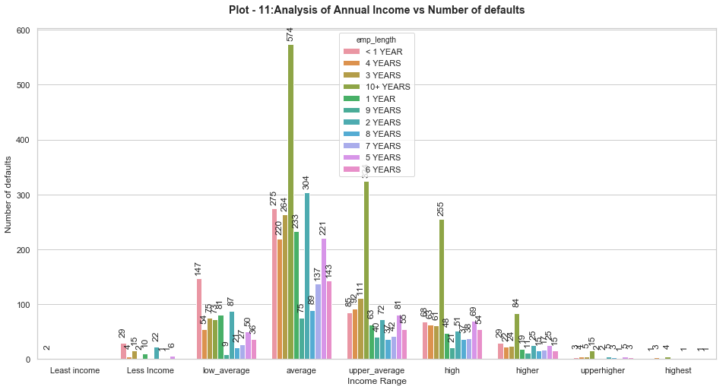
Annual Income Vs Employee length
Loan Applicants in the Average income zone(30000 - 60000) having experience >= 10 years are peak Defaulters.
We further zoom in to find the residential status of these 10+ years of experienced Applicant

Slide 15
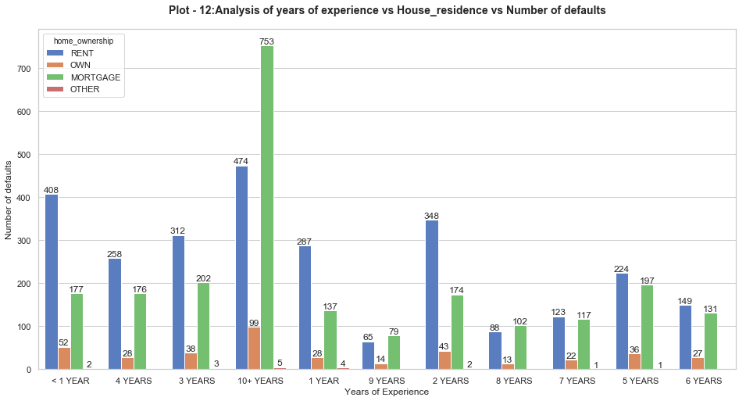
Years of Experience Vs House_residence
Applicants who do not own a House after 10 or more years of Experience have a high default Count
Summarizing the 2 slides:
Applicants who could not grow professionally in terms of Annual income in proportion to Work Experience peak the defaulters list

Slide 16
Conclusions
It has been noticed that 3 states CA, FL and NY are approving Loans without verifying. Almost 40% of Defaulters are from this 3 states. This 3 states should focus on verifying before Approving the Loan. It is also been observed that this 3 state’s consumers pay Installment late too
Nebraska has the maximum number of Defaulters. So this state’s loan applications need to be strictly scrutinized
Loan Applicants who are taking loan for Small Business are the maximum who are Defaulters which is around 27%. More investigation needs to be done on why this Purpose of Loan Consumers are unable to repay the loan
Loan Applicants who have taken medium interest rate 10-18% are the maximum defaulters. The interest rate needs to be reduced for this consumers
Loan Applicants who could not grow professionally in terms of Annual income in proportion to to Work Experience and do not own a house peak the defaulters list

